Slide 1
CSC-370 E - Commerce (BSc CSIT, TU)
Ganesh Khatri
kh6ganesh@gmail.com

Slide 2
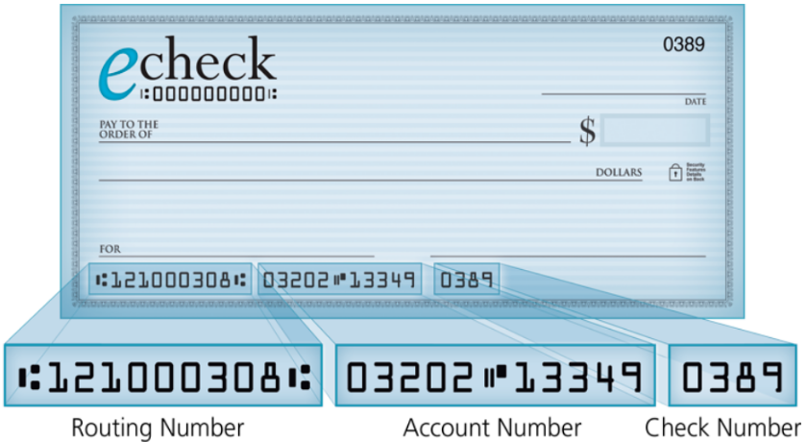
Electronic Checks
An electronic check, or e-check, is a form of payment made via the Internet, or another data network, designed to perform the same function as a conventional paper check.
Additionally, it has more security features than conventional paper check including authentication, public key cryptography, digital signatures, and encryption, etc.

Slide 3
Electronic Checks
Generally, the costs associated with issuing an electronic check are notably lower than those associated with paper checks
Electronic checks can be used to make a payment for any transaction that a paper check can cover, and are governed by the same laws that apply to paper checks
Generally, the costs associated with issuing an electronic check are notably lower than those associated with paper checks.
Electronic checks also come with a lower risk of the associated funds being stolen, as there is no tangible item to intercept
eChecks use the Automated Clearing House (ACH) to direct debit from a customer’s checking account into a merchant’s business bank account, with the help of a payments processor

Slide 4
How Electronic Checks work?
In order to accept eCheck payments, a business must first obtain the customer’s information including their bank routing and checking account numbers.
This information can be obtained online, by phone, or in person via a paper form.
Most businesses today have websites and can provide a secure form page for this customer information
Using this information, the merchant’s bank can communicate directly with a customer’s bank.
Once the funds are verified, the direct debit happens via ACH(Automated Clearing House)

Slide 5
How Electronic Checks work?
Following are the parties involved in ACH electronic check payment processing
An originator : The merchant cashing the eCheck. The originator initiates the direct deposit process by obtaining the necessary information from the customer
The business bank : The originator’s bank, also called the Originating Depository Financial institution (ODFI). The business bank places the ACH entry at the originator’s order, aggregates payments from a variety of customers, and sends the payments in batches to an ACH operator.
An ACH operator : The ACH operator sorts the fund request and settles the funds into the business bank.
The customer’s bank : a Receiving Depository Financial Institution (RDFI) receives the request, verifies that the funds are available, debits the customer’s account and credits the business account.

Slide 6
Benefits of Electronic Checks
Saves you time with your deposits - no more bank runs or long teller lines
Lowers traditional bank fees, like per item deposit and returned item fees
Funds you quickly
Secures your customer’s personal and bank account information by returning the original item to the check writer
Expandable equipment is simple and user friendly

Slide 7
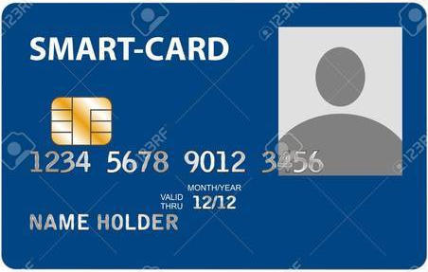
Smart Cards
A smart card is a device that includes an embedded integrated circuit chip (ICC) that can be either a secure microcontroller or equivalent intelligence with internal memory or a memory chip alone
The card connects to a reader with direct physical contact or with a remote contactless radio frequency interface.
With an embedded microcontroller, smart cards have the unique ability to store large amounts of data, carry out their own on-card functions (e.g., encryption and mutual authentication) and interact intelligently with a smart card reader

Slide 8
Smart Cards
Smart card technology is available in a variety of form factors, including plastic cards, fobs, subscriber identity modules (SIMs) used in GSM mobile phones and etc
Based on the working mechanism, there are three types of smart cards :
Contact Smart Card
Contactless Smart Card
Hybrid Smart Card

Slide 9
Smart Cards
Contact Smart Card :
most common smart cards in use.
ATM cards, most credit cards, SIM cards etc fall into this category.
the cards should be inserted into card readers, it reads the information stored on the contact pad and carry out transactions as required

Slide 10
Smart Cards
Contactless Smart Card :
these cards do not require a reader.
It works using Near Field Communication technology or using radio frequencies which establishes wireless communication between the smart card and card reader.

Slide 11
Smart Cards
Hybrid Smart Card :
Hybrid cards are cards with dual capacity.
These cards can work both on contact and contactless card readers.
These cards are quite rare in use
This type of smart card can has two chips, one with a contact interface and one with a contactless interface
A dual-interface card has a single chip with both contact and contactless interfaces and it is possible to access the same chip using either a contact or contactless interface

Slide 12
Applications of Smart Cards
Secure identity applications :
employee ID badges, citizen ID documents, electronic passports, driver’s licenses, online authentication devices
Healthcare applications :
citizen health ID cards, physician ID cards, portable medical records cards
Payment applications :
contact and contactless credit/debit cards, transit payment cards
Telecommunications application :
GSM Subscriber Identity Modules, pay telephone payment cards

